Slide 1
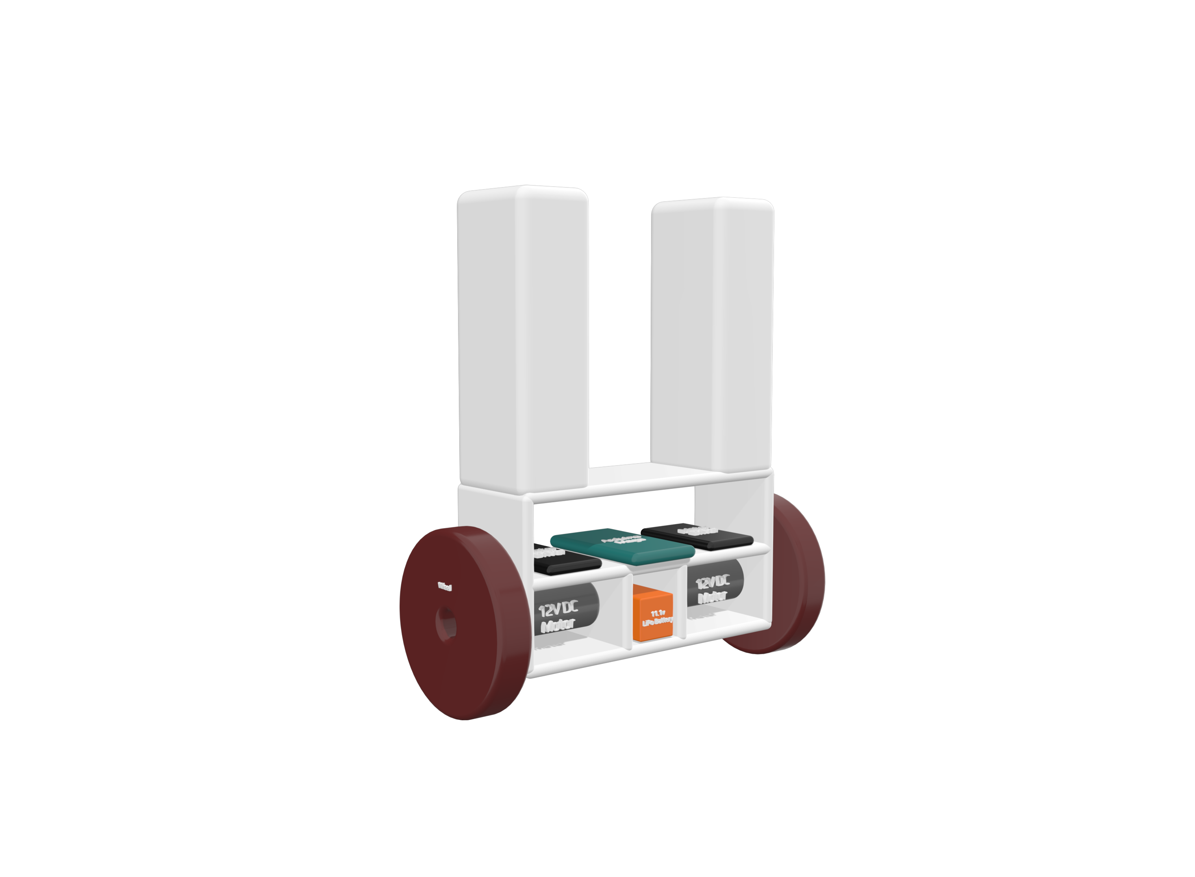


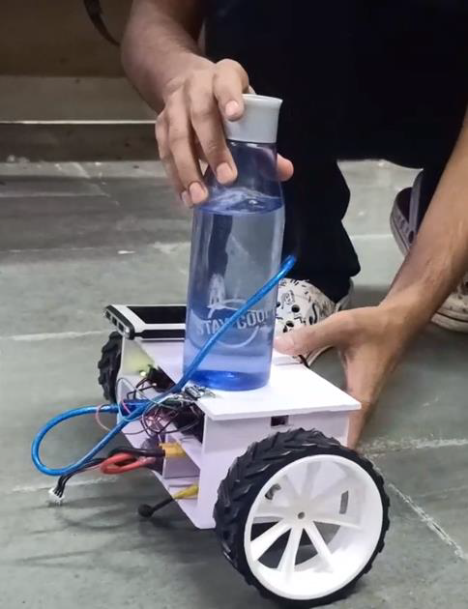

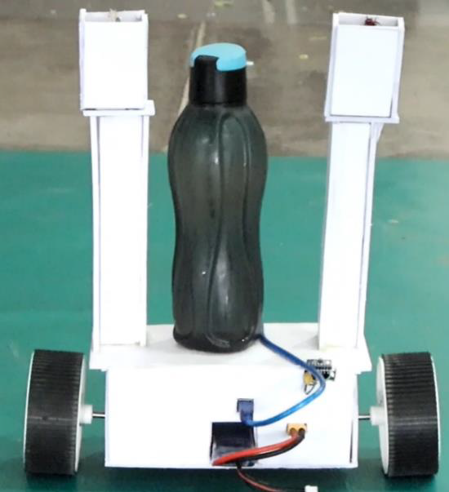


INTRODUCTION
TWO WHEELED
SELF BALANCING ROBOT
DAIICT, GANDHINAGAR
The two-wheeled self-balancing robot is a robotic platform with two independently moving wheels.
Its behavior is comparable to a traditional mechanical system using an inverted pendulum.
Unique stability control is required to keep the robot upright.

Slide 2

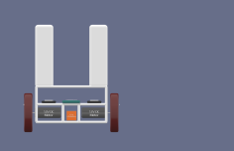


INTRODUCTION
1
The self-balancing robot is a two-wheeled vehicle designed with sensors and control mechanisms, enabling it to maintain balance during movement. Emulating the behavior of an inverted pendulum, the robot employs sophisticated control algorithms to ensure the center of mass stays above the pivot point.
Utilizing sensors like accelerometers and gyroscopes, it receives real-time feedback, allowing for precise control and stability. In addition to its self-balancing prowess, the robot incorporates line-following capabilities, enhancing its versatility for navigating paths in various environments.

Slide 3
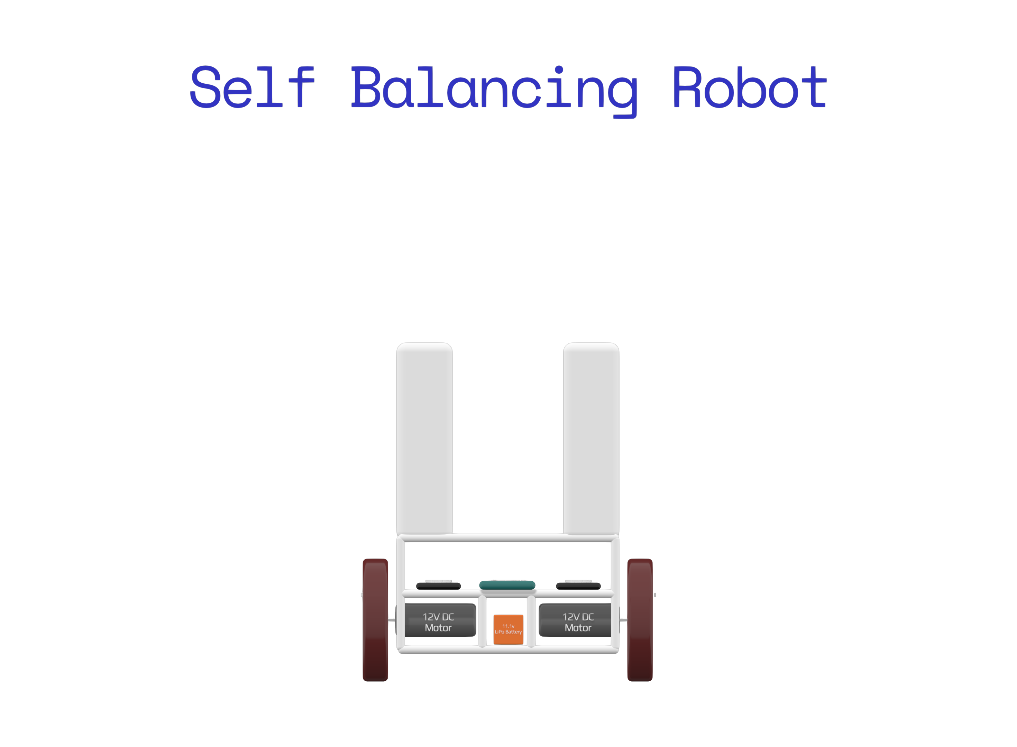

2
ROBOT STRUCTURE
The robot consists of three levels of platforms balanced over two wheels.
The bottom platform houses the motors and battery.
An array of IR sensor is attached below the bottom platform for line following.
The middle platform contains other electrical and mechanical components.
The upper platform is used for placing objects to be transported.

Slide 4

COMPONENTS USED
3
Arduino Mega 2560 Rev3 (Microcontroller)
Cytron 10 A Switch Control Potentiometer DC Motor Driver DC 12V (Motor Driver)
MPU6050 - Triple Axis Gyro Accelerometer Module (Sensors)
LiPo Battery 2200 mAh 11.1V, 1800 mAh 5V Battery (Batteries)
ROBOT WHEEL 10.5 CM DIAMETER 4.4 CM WIDTH (Wheels)
200RPM HIGH TORQUE QUAD ENCODER MOTOR (Motors)

Slide 5
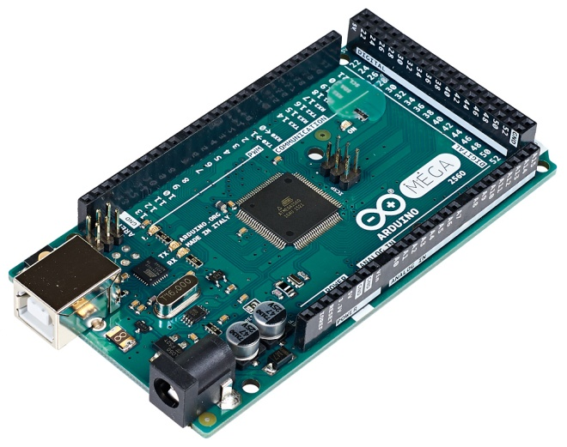
4
COMPONENTS USED
Arduino Mega 2560 Rev3 (Microcontroller)
Cytron 10 A Switch Control Potentiometer DC Motor Driver DC 12V (Motor Driver)
MPU6050 - Triple Axis Gyro Accelerometer Module (Sensors)
LiPo Battery 2200 mAh 11.1V, 1800 mAh 5V Battery (Batteries)
ROBOT WHEEL 10.5 CM DIAMETER 4.4 CM WIDTH (Wheels)
200RPM HIGH TORQUE QUAD ENCODER MOTOR (Motors)
Array Of 7-IR Sensors

Slide 6

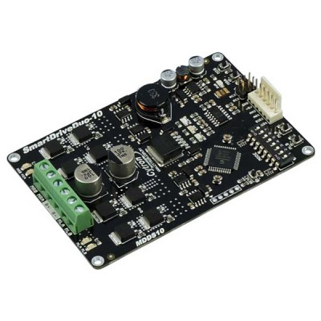
5
COMPONENTS USED
Arduino Mega 2560 Rev3 (Microcontroller)

Slide 7
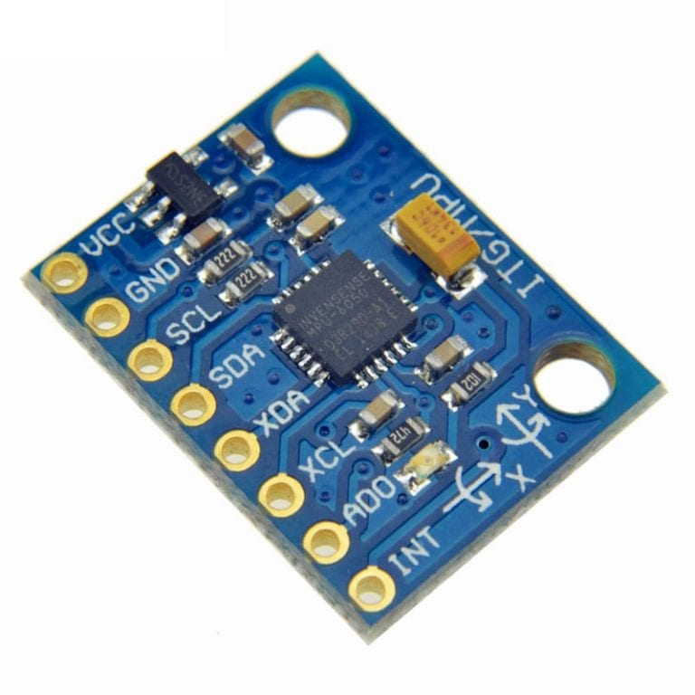

5
COMPONENTS USED
Cytron 10 A 12V DC Motor Driver

Slide 8
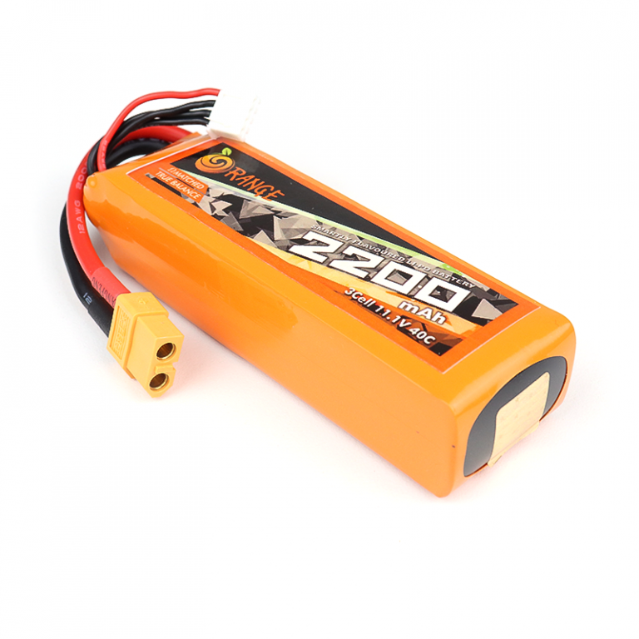
5
COMPONENTS USED
MPU6050 -Triple Axis Gyro Accelerometer

Slide 9
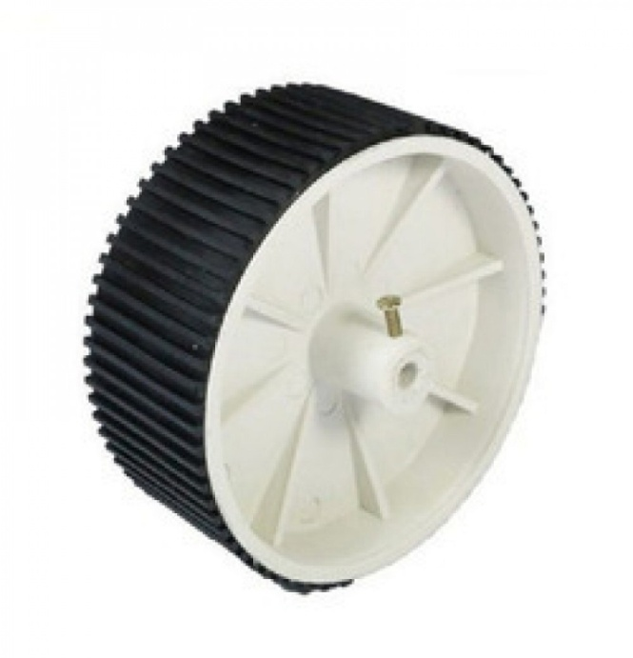
5
COMPONENTS USED
2200 mAh LiPo Battery

Slide 10

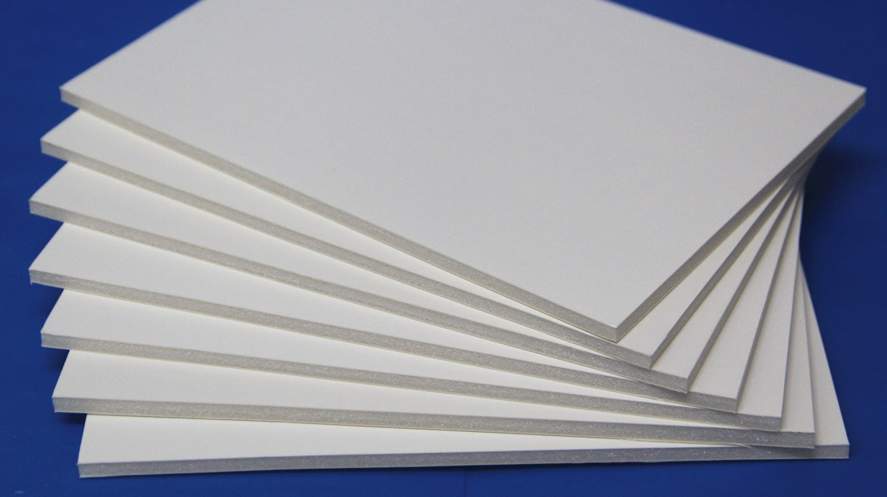
5
COMPONENTS USED
Robot Wheels

Slide 11
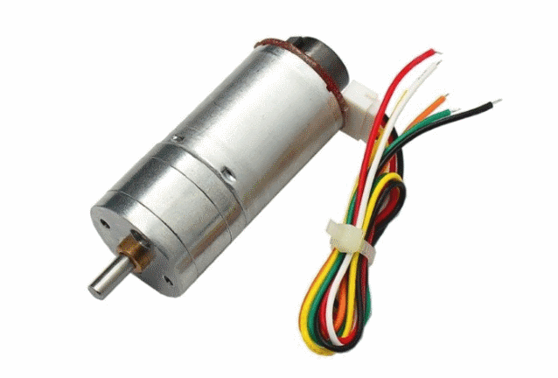

5
COMPONENTS USED
Foam Sheet

Slide 12
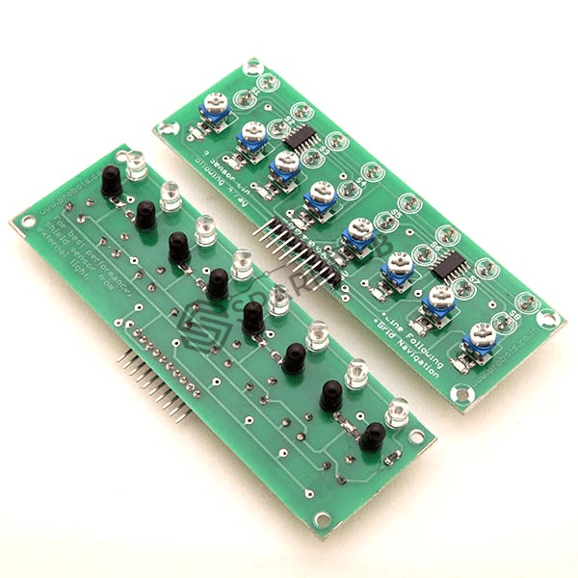

FEATURES OF THE ROBOT
5
COMPONENTS USED
12v DC Motor With Encoders
Stay upright
Straight line movement without needing external control.
Capability to carry and transport 1kg load upto more than 150m distance.

Slide 13
FEATURES OF THE ROBOT
5
COMPONENTS USED
IR Sensor Array
Stay upright
Straight line movement without needing external control.
Capability to carry and transport 1kg load upto more than 150m distance.

Slide 14
6
ADDITIONAL FEATURES
FEATURES OF THE ROBOT
The robot stays upright
Straight line movement without needing external control.
Able to carry and transport loads exceeding 1kg and travel distances greater than 200 meters
Follows Line
The robot can navigate uphill and downhill over inclined surfaces.
It can also stay still on an inclined surface if required.
The robot maintains stability while moving over small obstacles

Slide 15
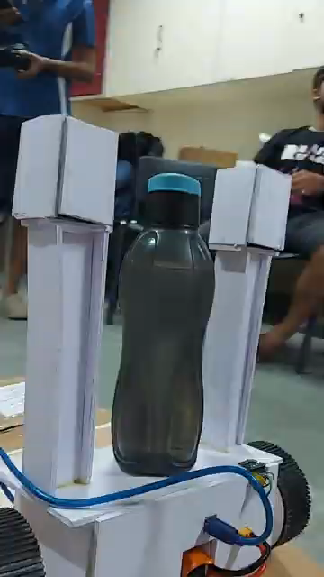
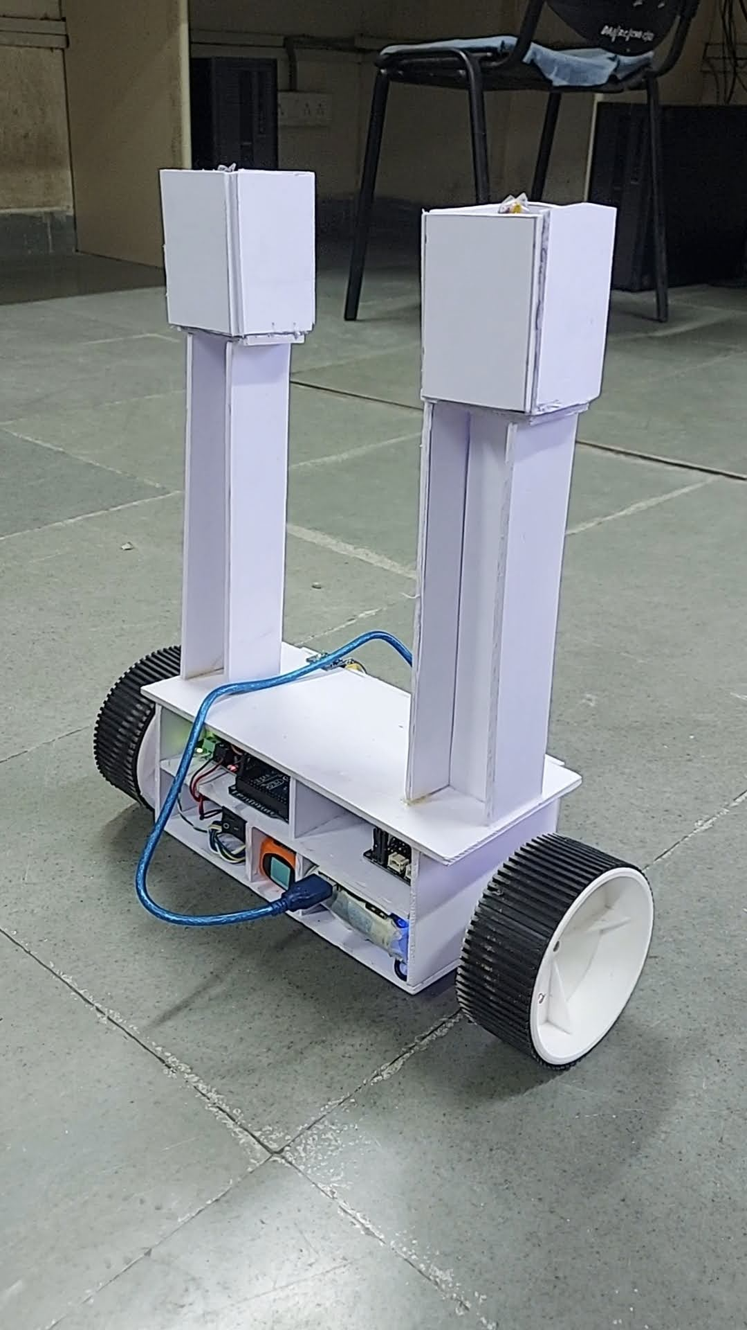
DELIVERABLES
ACHIEVED
7
ADDITIONAL FEATURES
The robot can navigate uphill and downhill over inclined surfaces.
It can also stay still on an inclined surface if required.
The robot maintains stability while moving over small obstacles
The Robot: can stand freely and maintain its balance.
Chasis is custom-made from scratch, without readymade kits.
The robot is highly manoeuvrable, physically accessible, and can travel moderately.
The Robot has a carrying capacity of over 1 kg and transport load to 150+ m distance

Slide 16
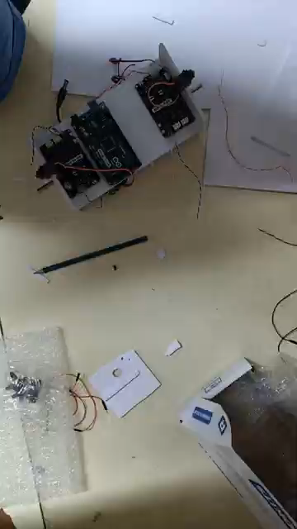
8
DELIVERABLES
ACHIEVED
The Robot: can stand freely and maintain its balance.
Chasis is custom-made from scratch, without readymade kits.
The robot is highly manoeuvrable, physically accessible, and can travel moderately.
The Robot has a carrying capacity of over 1 kg and transport load to 200+ m distance

Slide 17
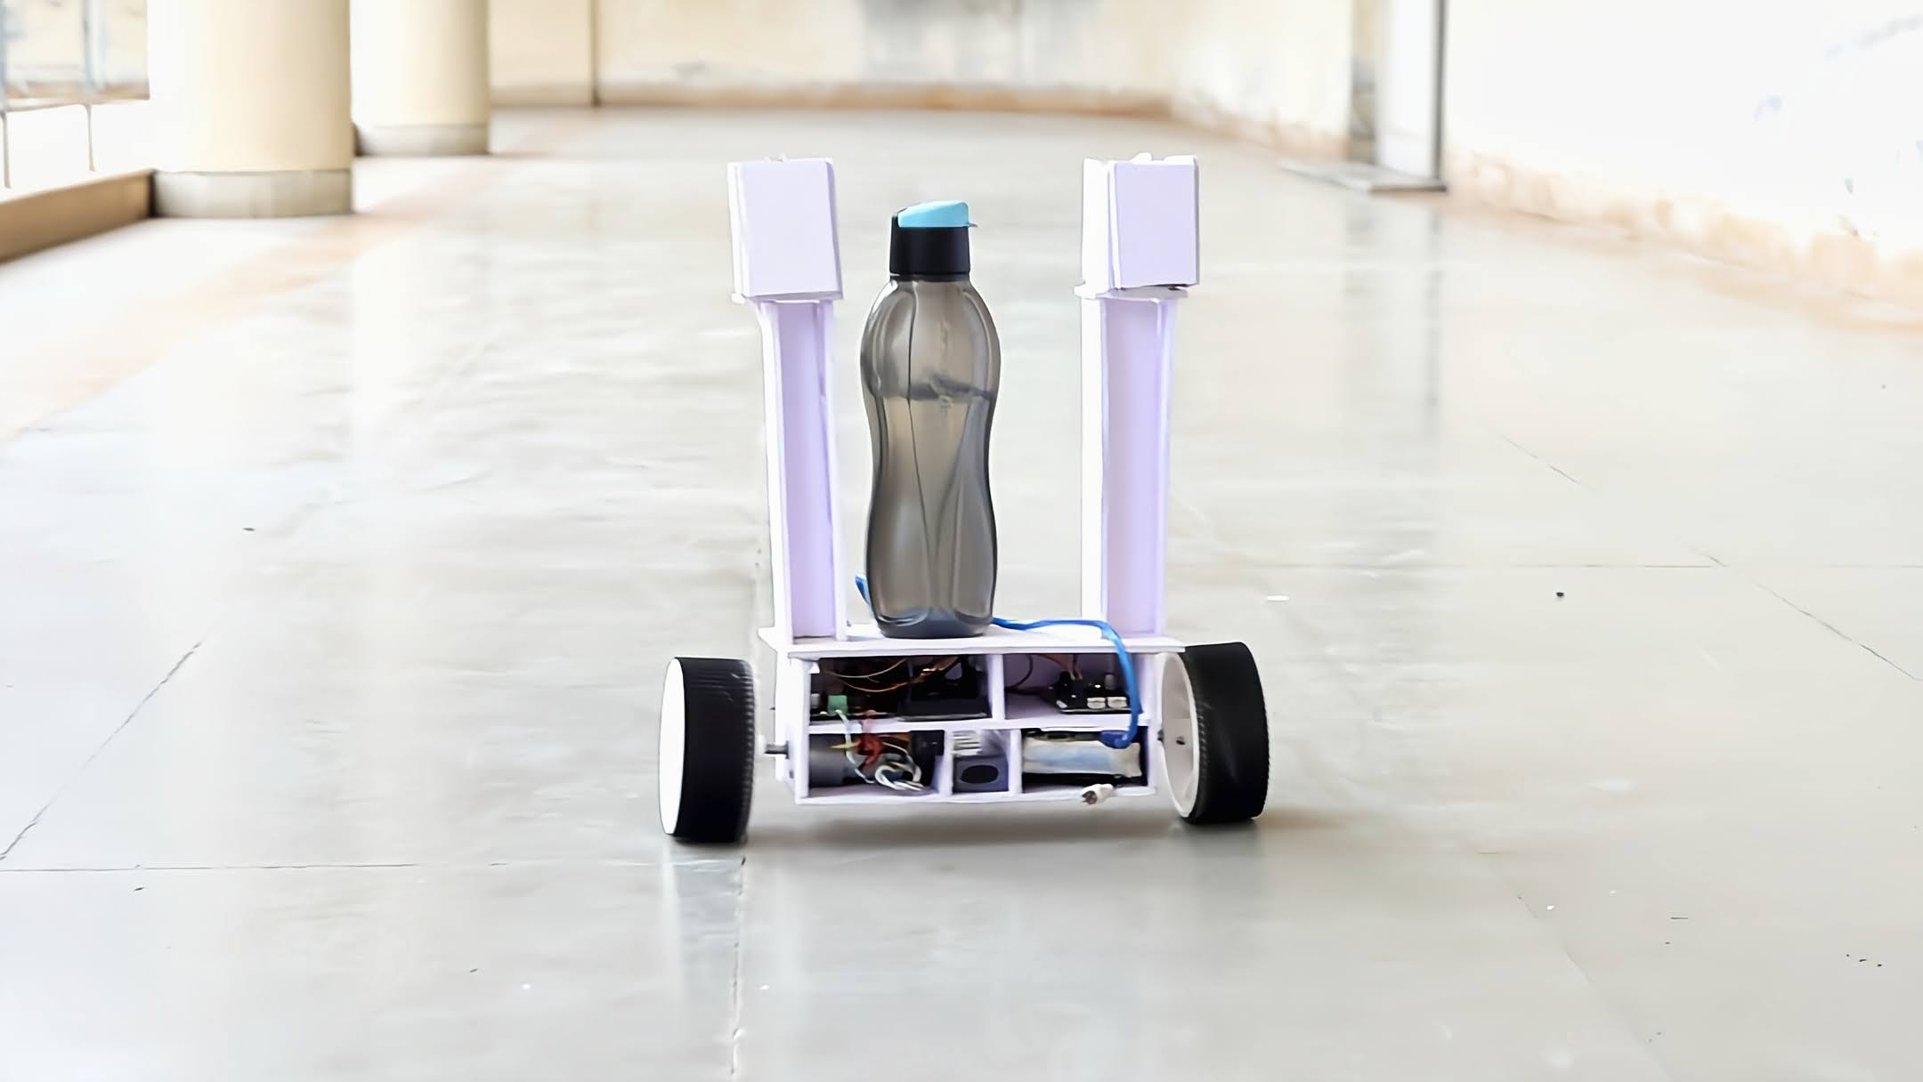
8
DELIVERABLES
ACHIEVED
The Robot: can stand freely and maintain its balance.
Chasis is custom-made from scratch, without readymade kits.
The robot is highly maneuverable, physically accessible, and can travel moderately.
The Robot has a carrying capacity of over 1 kg and transport load to 200+ m distance

Slide 18
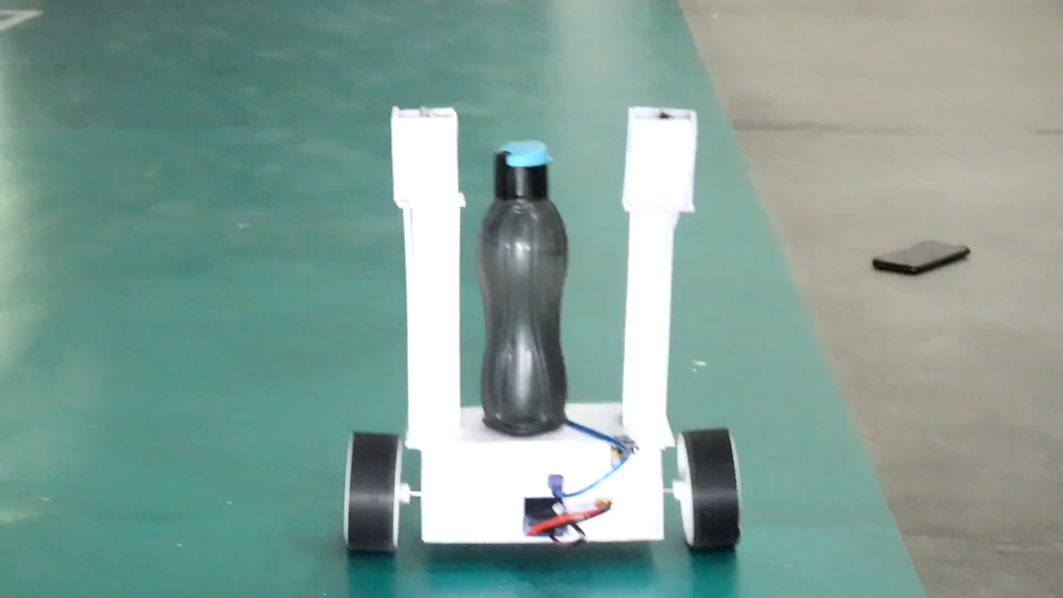
8
DELIVERABLES
ACHIEVED
The Robot: can stand freely and maintain its balance.
Chasis is custom-made from scratch, without readymade kits.
The robot is highly maneuverable, physically accessible, and can travel moderately.
The Robot has a carrying capacity of over 1 kg and transport load to 200+ m distance
No external controls are given. It is solely battery-operated

Slide 19

THANK YOU
8
DELIVERABLES
ACHIEVED
No external controls are given. It is solely battery-operated.
Follows Black Line
Video Link : Final_Robot.Mp4

Slide 20

9
CHALLENGES FACED IN ROBOT MAKING
ADDITIONAL FEATURES
Battery issues: The battery burned and damaged multiple times.
Wiring issues: The wires were not able to handle the heat and were also burning.
Motor issues: Initially, simple DC motors were used but they couldn’t handle the weight. High torque motors were used as a replacement but they caused the whole body to move.
The robot can navigate uphill and downhill over inclined surfaces.
It can also stay still on an inclined surface if required.
The robot maintains stability while moving over small obstacles

Slide 21
THANK YOU

